Slide 1

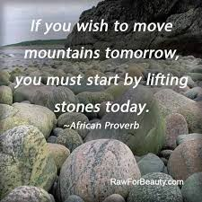
The MAD Approach: Mad About Deadlines
Know where you going to
Understand what will be required of you
Decide what you want
Be willing to go the distance
Eliminate your distractions
Feed your focus
Turn your intentions into habits
You’ve got this! Believe!
Stretch…Reach…Succeed
You will! You must! You can!
YOUR SUCCESS MATTERS! YOU CAN CHANGE YOUR WORLD
Learning Development, NORTH CAMPUS, R-BLOCK, R106, T: 041 504 3241/ 9055
LT Collab

Slide 2
The MAD Approach: Mad About Deadlines
Zazi apho uya khona
Yiqonde into eya kufunwa kuwe
Gqiba ngento oyifunayo
Vuma ukuhamba umgama/
susa izinto ezikuphazamisayo
Yondla izinto ozakuzinika igqalelo
Jika imikhwa yakho ibe uyenze injongo
Kholwa ukuba uyayiqonda lento
Yolula…Fikelela…Phumelela
Uzakwenza njalo! Unyanzelekile! Uyakwazi!
IMPUMELELO YAKHO IBALULEKILE! UNGALITSHINTSHA ILIZWE LAKHO
Learning Development, NORTH CAMPUS, R-BLOCK, R106, T: 041 504 3241/ 9055
LT Collab

